Slide 1

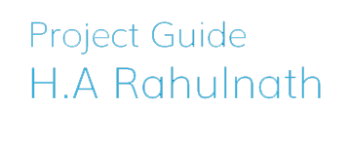
IoT Assisted Godown Management System

Slide 2
Problem defenition
To create a centralized system for monitoring storage and management of food items within a number of storage areas under government to ensure transparency and avoid risk of wastage.

Slide 3
Solution
A website which holds information of different warehouses/godowns with each of its commodities and their live availability. It is developed to ensure transparency in the field of public food storage and to avoid the risk of hoarding and price hike.
This system is designed to monitor the inflow and outflow of each commodity in every godown under a single authority and make digital records which can be exposed to public.
An IOT device based on RFID Scanner is integrated with this web app to record the movements of commodities to and from each godown automatically.
1

Slide 4
Users
Super Admin
Godown Manager
Public

Slide 5
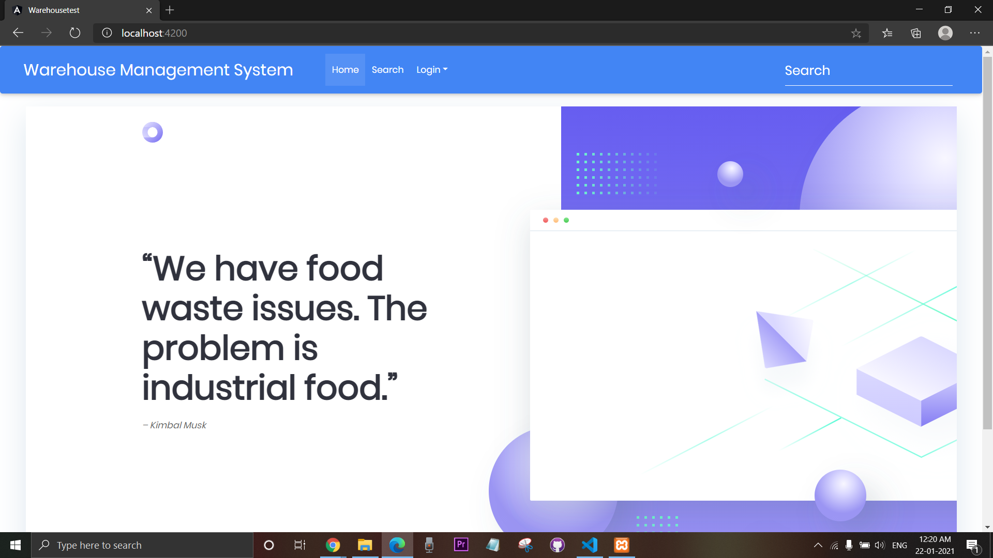
Home page

Slide 6
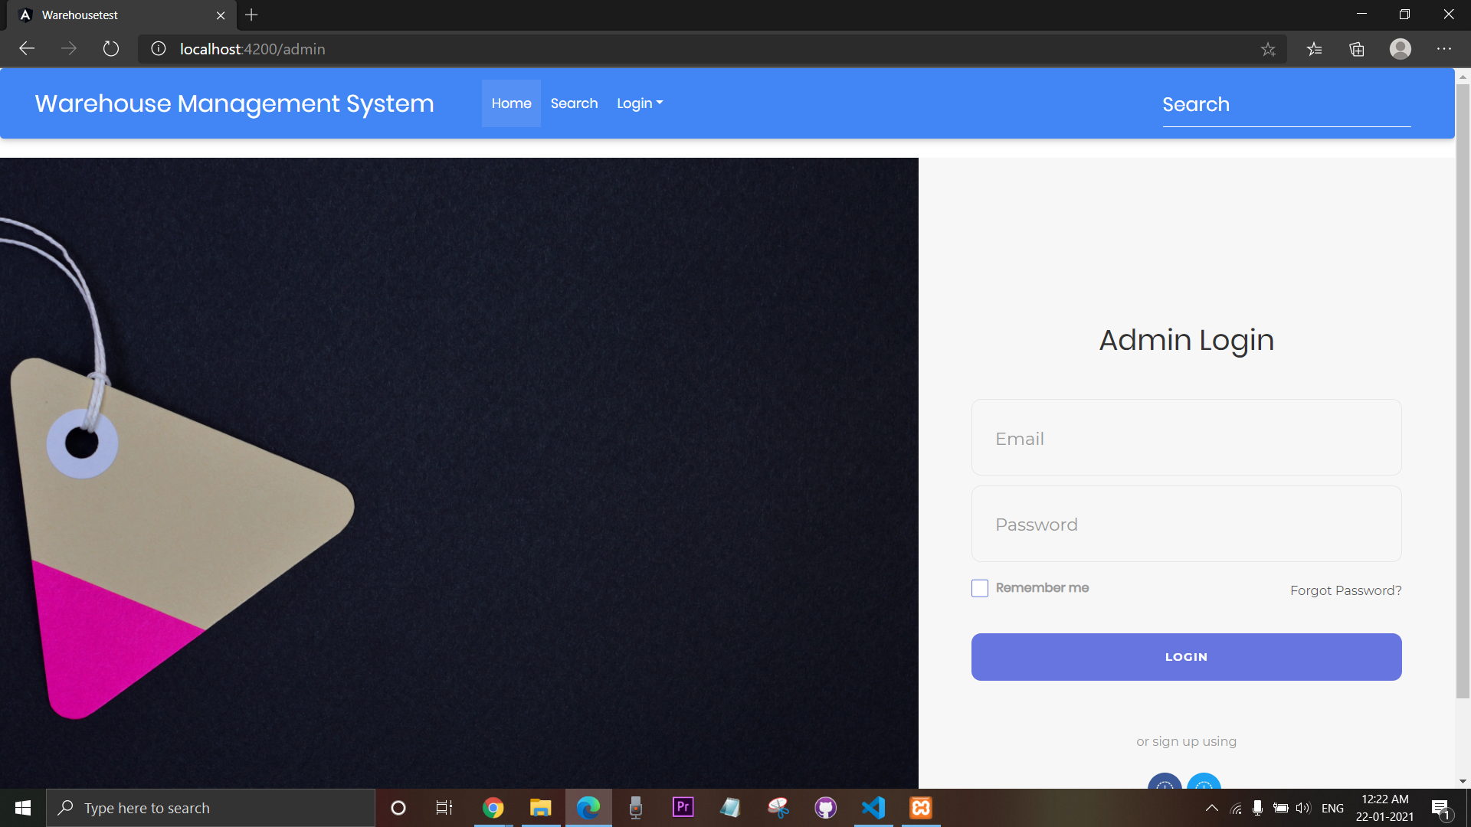
Admin Login

Slide 7
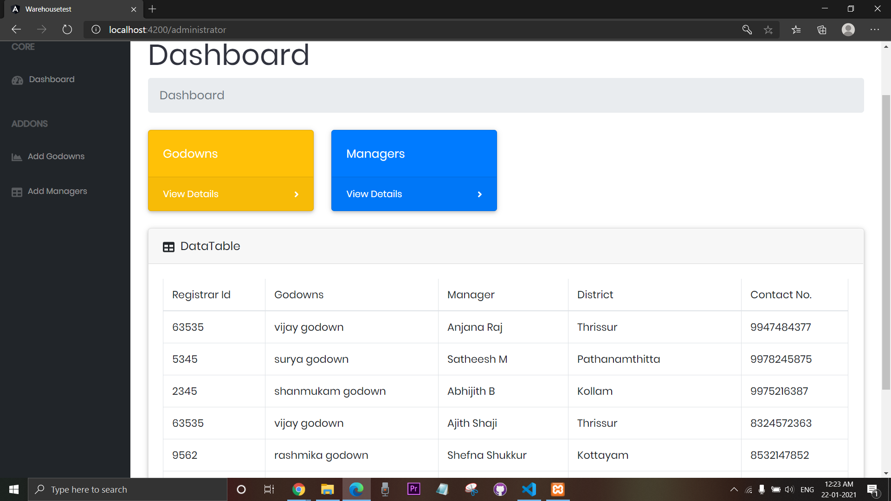
Admin Dashboard

Slide 8
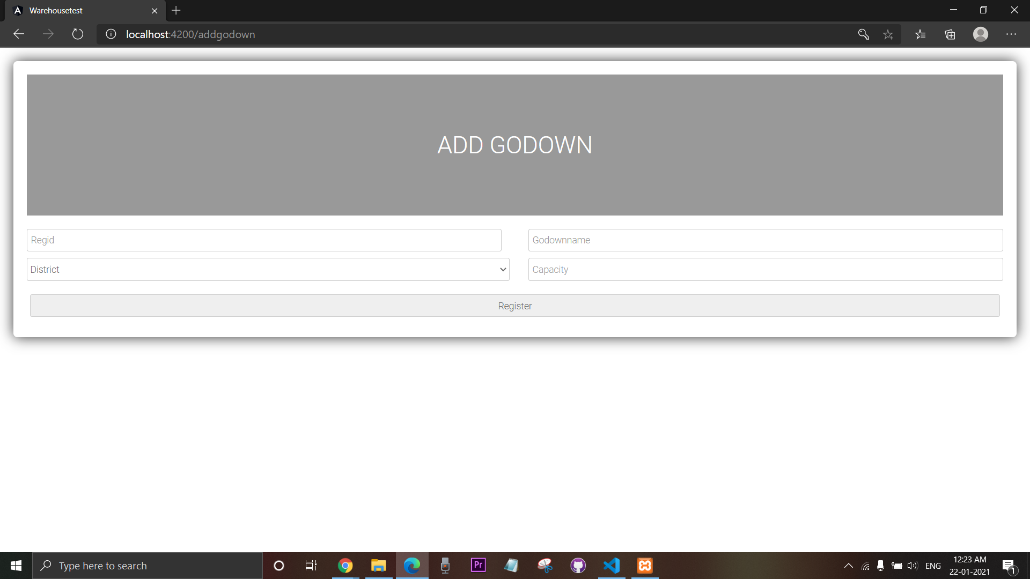
Adding Godowns

Slide 9
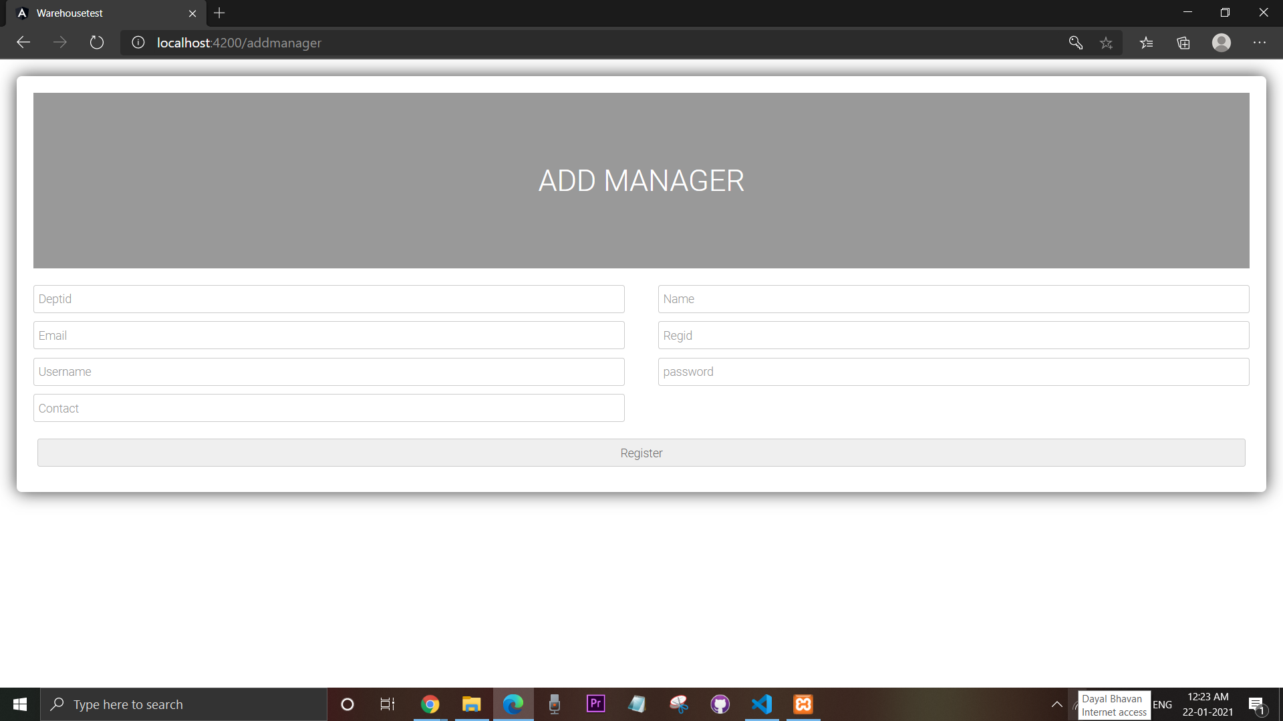
Adding Managers

Slide 10

Manager Login

Slide 11
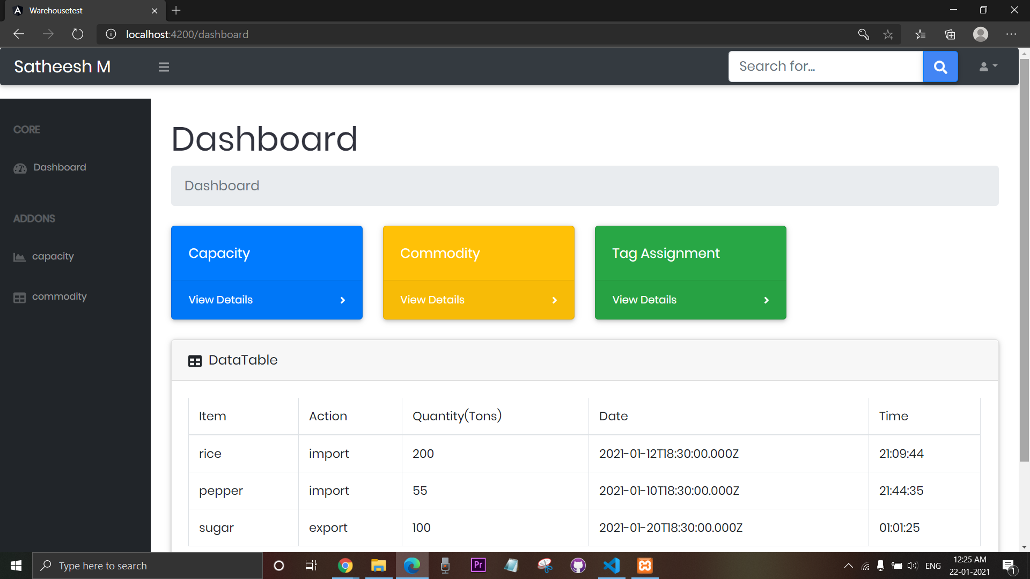
Manager Dashboard

Slide 12
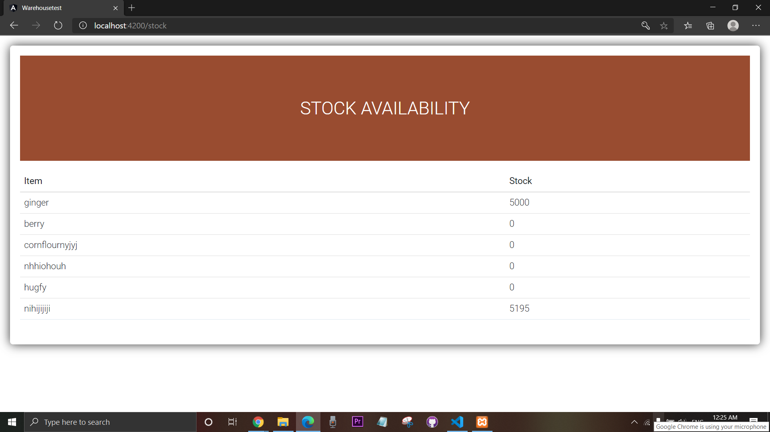
View Stock

Slide 13

Adding Commodity

Slide 14
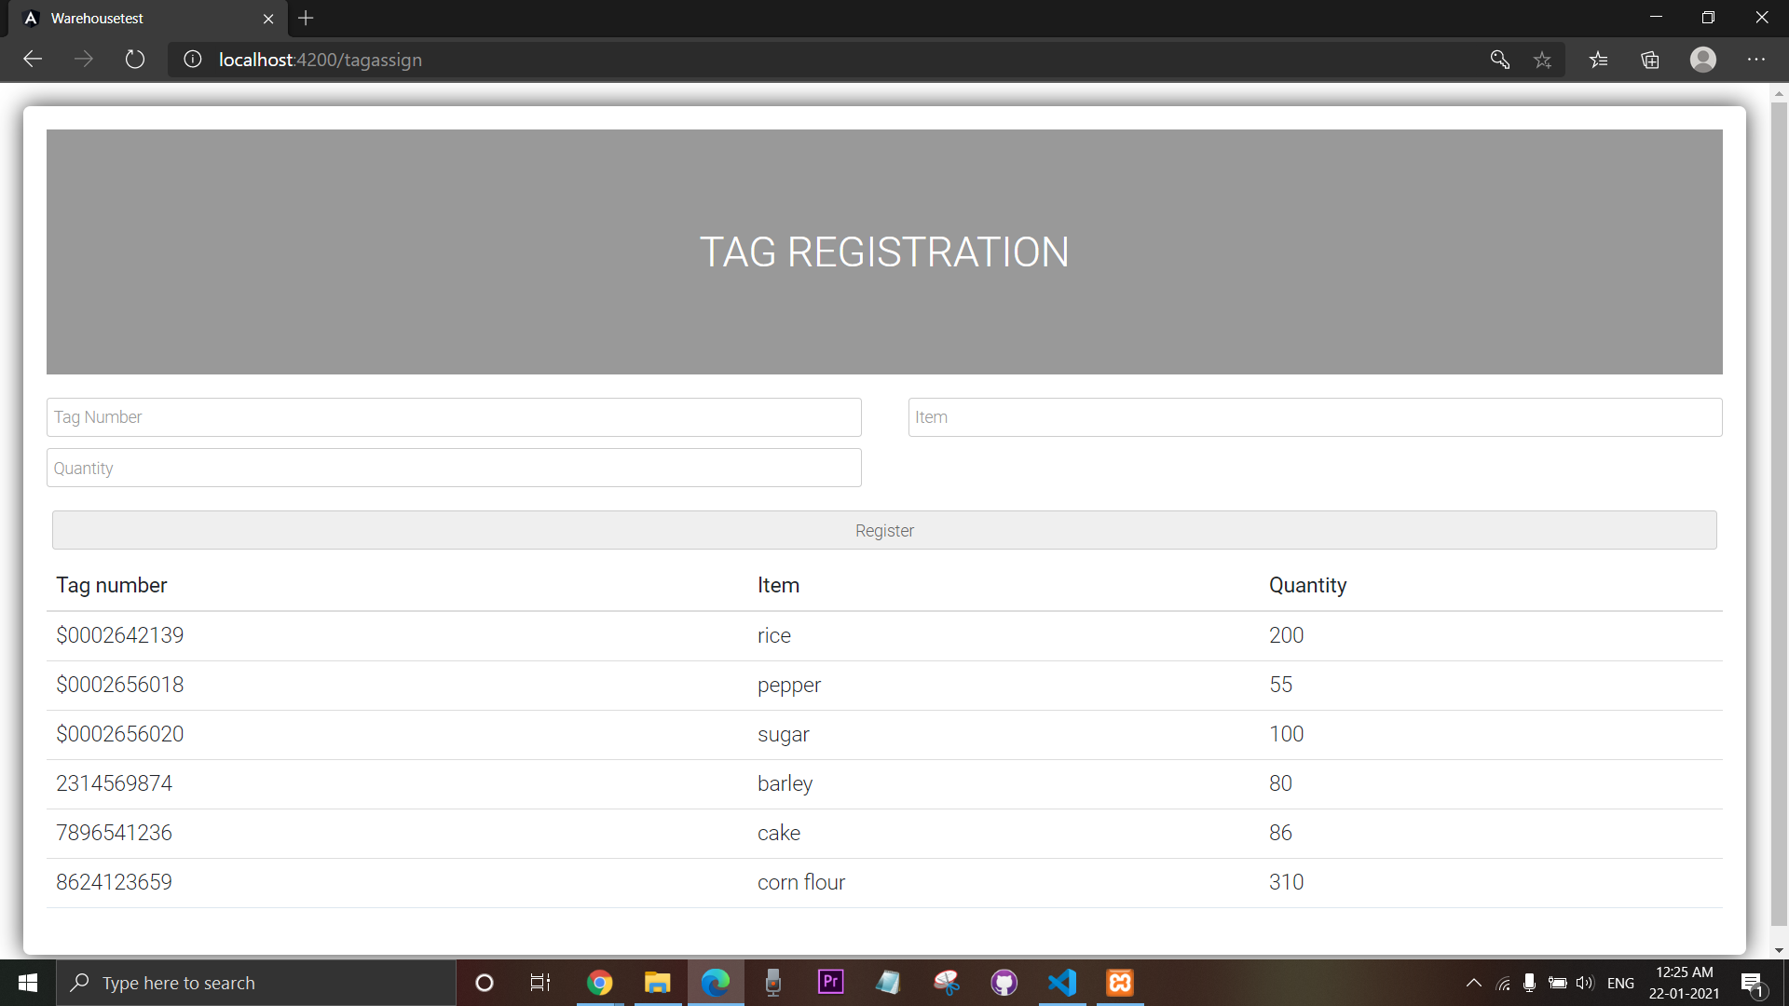
New Tag Registration

Slide 15
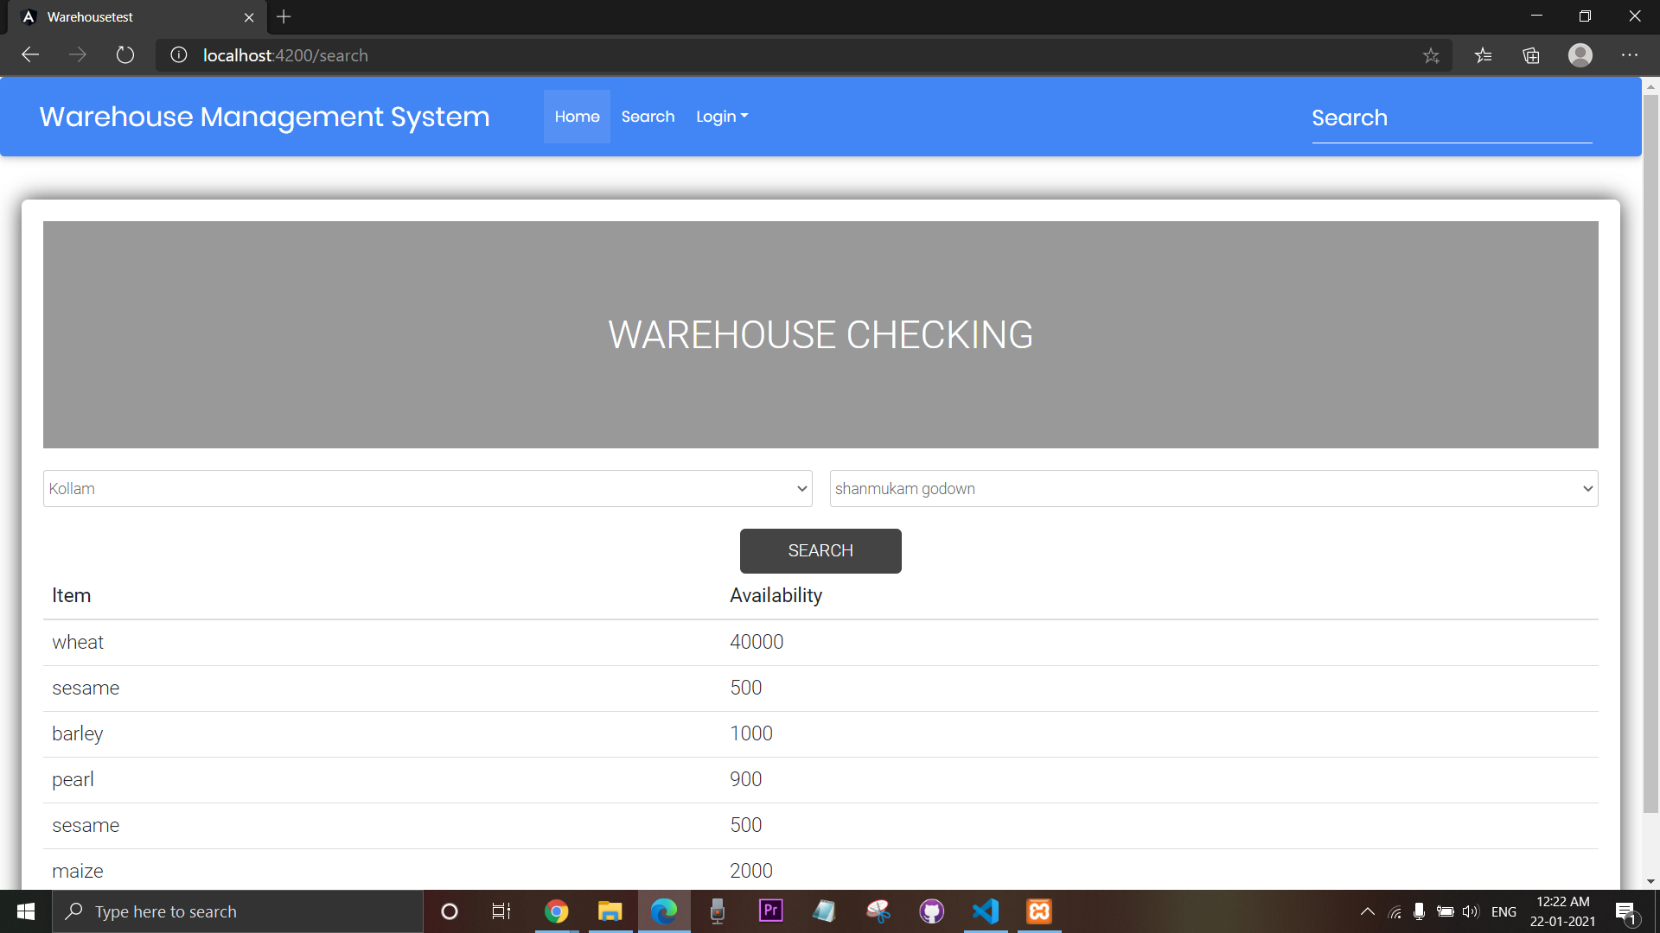
Public Godown Search

Slide 16
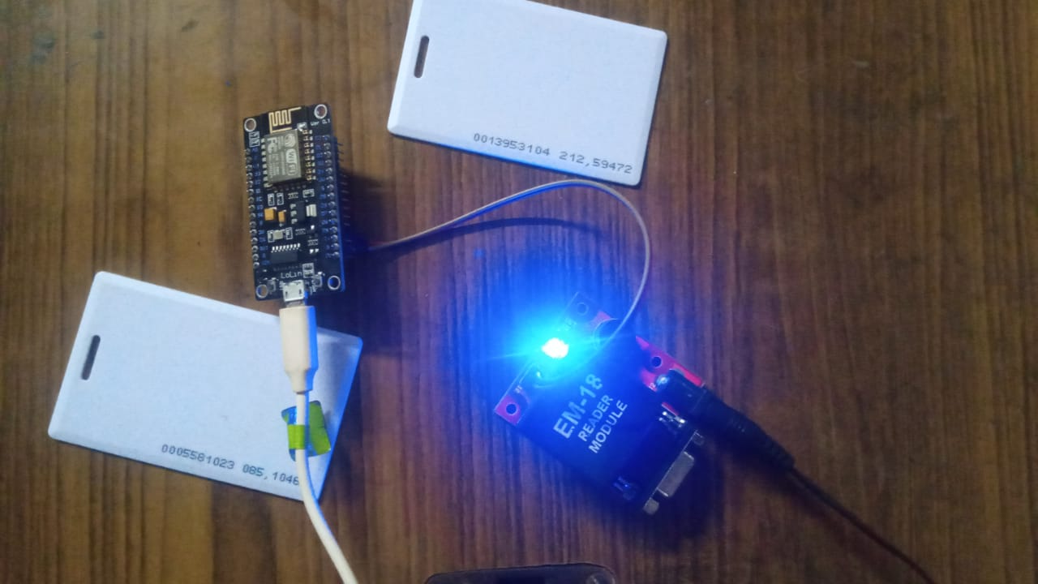
IoT Device

Slide 17
Technology Used
Software
Front end : Angular JS
Back end : My SQL
Hardware
EM-18 RFID Scanner
ESP8266 NodeMCU

Slide 18
Thanks!
Any questions?

